Slide 1
DATA SEARCH DATA SCIENCE JOB POSTING TREND ANALYSIS
By: David karanja Mwangi
Data analyst

Slide 2
introduction
Data Search is a recruiting firm that links job seekers with potential employers. The objective of the analysis is to uncover job trends in the data science field.

Slide 3
The Problem
What is the problem?
The data field is relatively new with various jobs that require specific skills. Most of the skills overlap hence difficult for Data Search to effectively fulfill its mandate.

Slide 4
Task
Discover trends in jobs and skills within the data science field
1.What are the most popular jobs in Data science?
2.What is the average salary of roles in Data Science?
3. How frequently are job postings being posted?
4. Which job position level is in most postings?
5. Which skills correlate to the job postings?
6. What are the top skills in demand

Slide 5
Task
7. Which industries have the most competitive salaries?
8. Which companies sizes have the most job postings?

Slide 6
Background Information
Data source
This is a fictitious data set.
Analysis tool
Microsoft Power BI

Slide 7
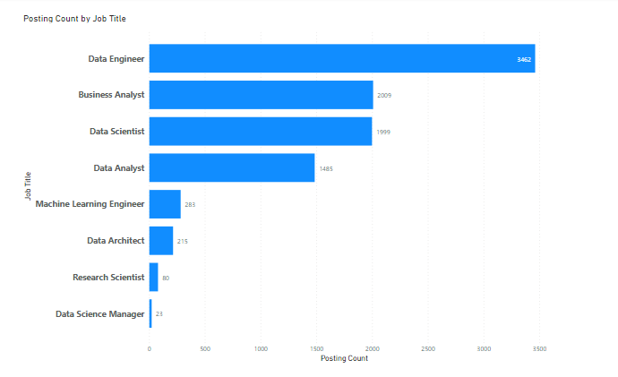
What are the most popular jobs in data science?
Data Engineer is the most popular while data science manager is the least.

Slide 8
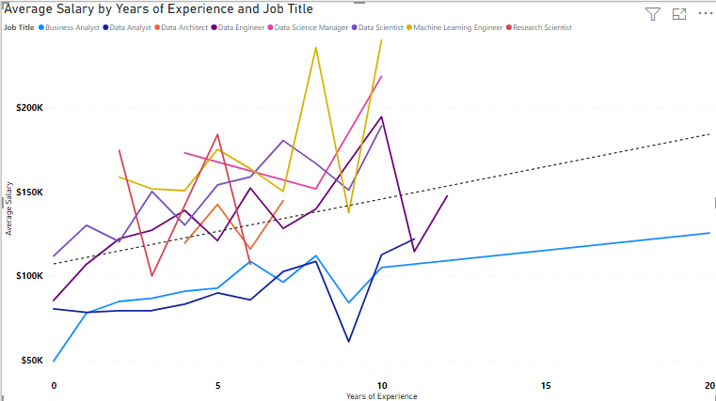
What is the average salary of roles?

Slide 9
Salary insights
The trend line shows salaries in the data science field are on an upward trajectory in relation to years of experience.
With 0 years of experience, annual average salary is:
1. Data Scientist - $111,929
2. Data Engineer - $85,500
3. Data Analyst - $80,500
4. Business Analyst - $49,500

Slide 10
SALARY INSIGHTS
A professional with 3 years experience earns:
1. Machine learning Engineer - $151,667
2. Data Scientist - $150,125
3. Data Engineer - $127,250
4. Research Scientist - $100,000
5. Business Analyst – $86,782
6. Data Analyst – $79,500

Slide 11
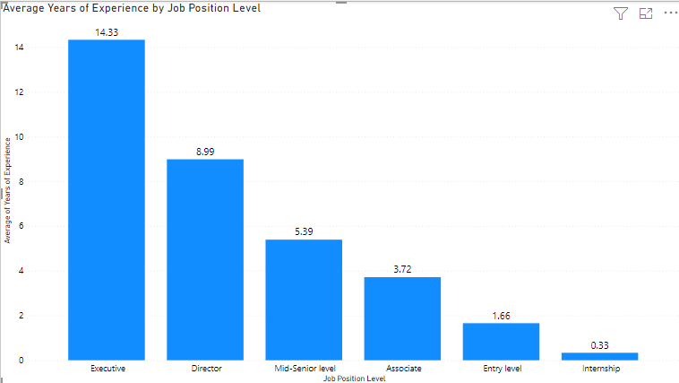
How many years of experience are in different job levels?

Slide 12
YEARS OF EXPERIENCE IN JOB LEVELS
Internship positions need the least experience which is less than a year or 0.33years.
Entry level requires slightly over a year and a half of experience, 1.66 years.
Associate – 3.72 years
Mid Senior Level – 5.39 years
Director – 8.99 years
The senior most level is Executive which has an average experience of over 14 years

Slide 13
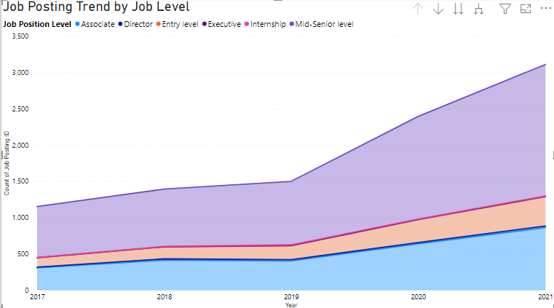
How frequently are job postings being posted?

Slide 14
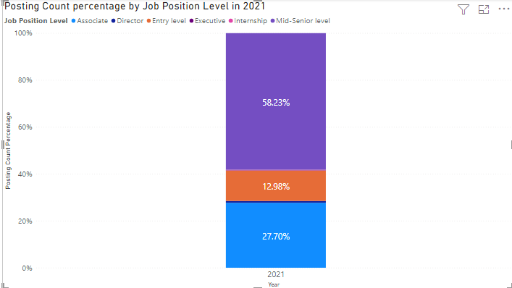
Job posting trend in the past 5 years
Between 2017 and 2021, data science job postings have been rising. A sharp rise is detected from 2019.
In 2021,Mid senior level takes the highest proportion of postings followed by associate and Entry level.

Slide 15
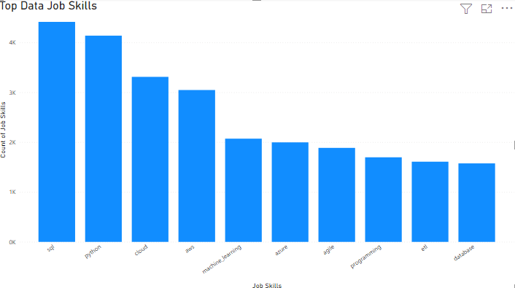
Top 10 data skills in job postings

Slide 16
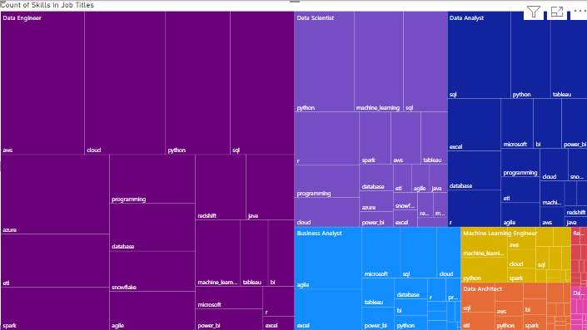
Skill set of different data jobs
The tree map shows main skills of top data science roles

Slide 17
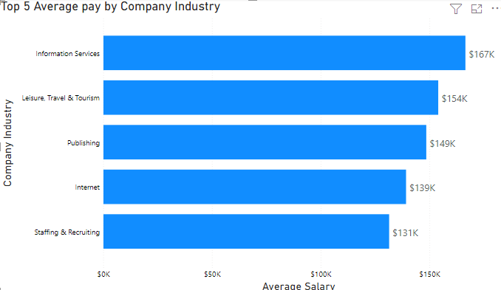
Company industries with the most competitive salaries

Slide 18
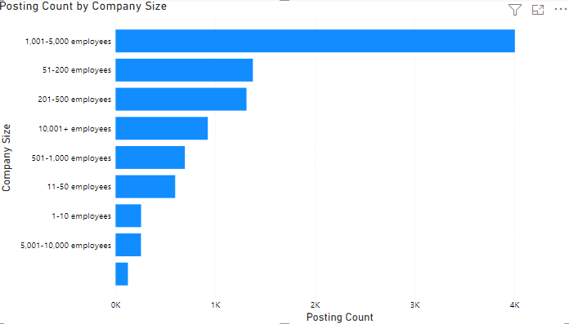
Postings by company size

Slide 19
Postings by company size
Companies with an employee number of between 1000 to 5000 had the highest number of postings.
A very big difference in numbers is noted compared to the other company sizes.

